Slide 1
Book1
File created on: 28/05/2022 11:48:29

Slide 2
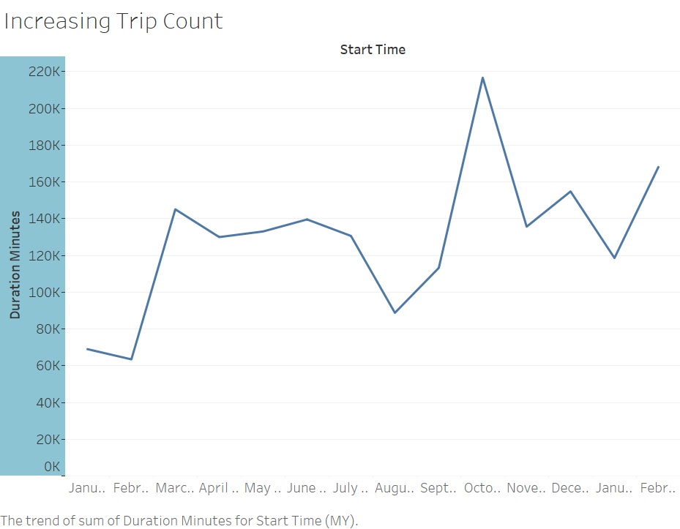

Slide 3
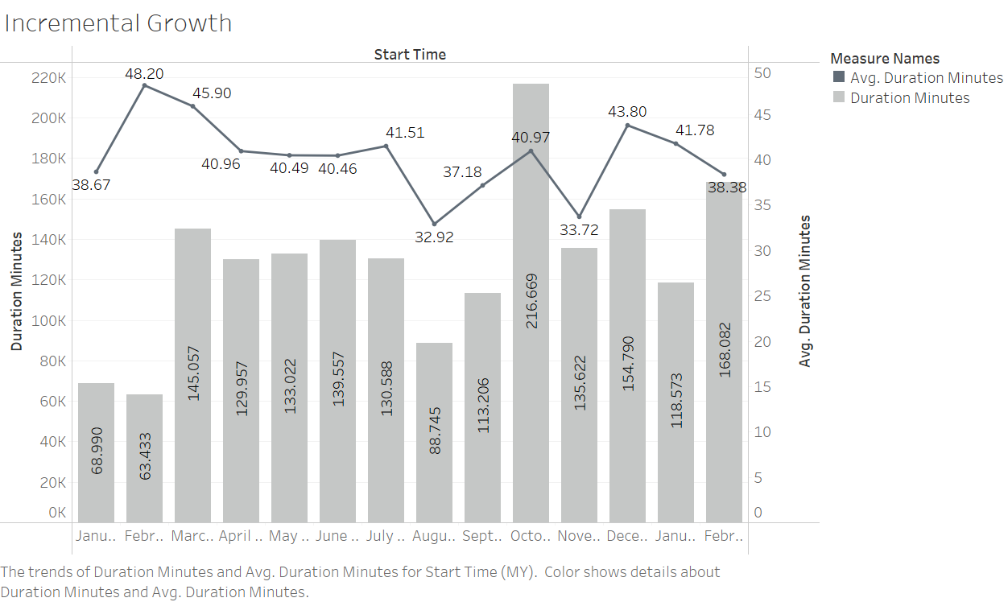

Slide 4
